Slide 1



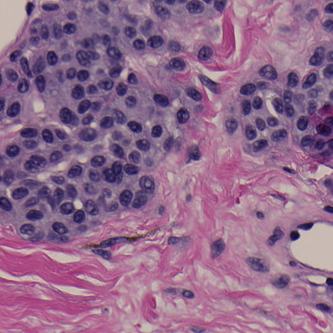

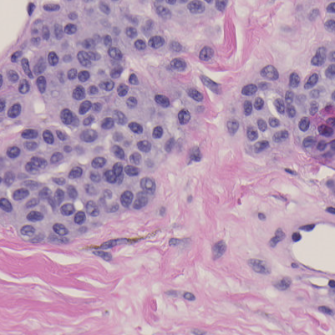

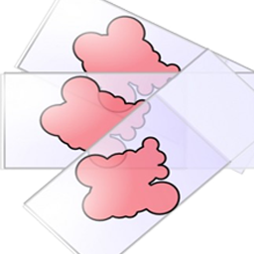

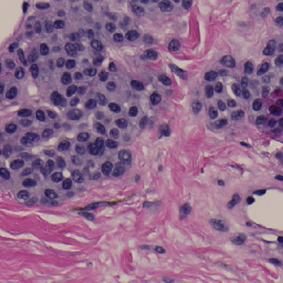
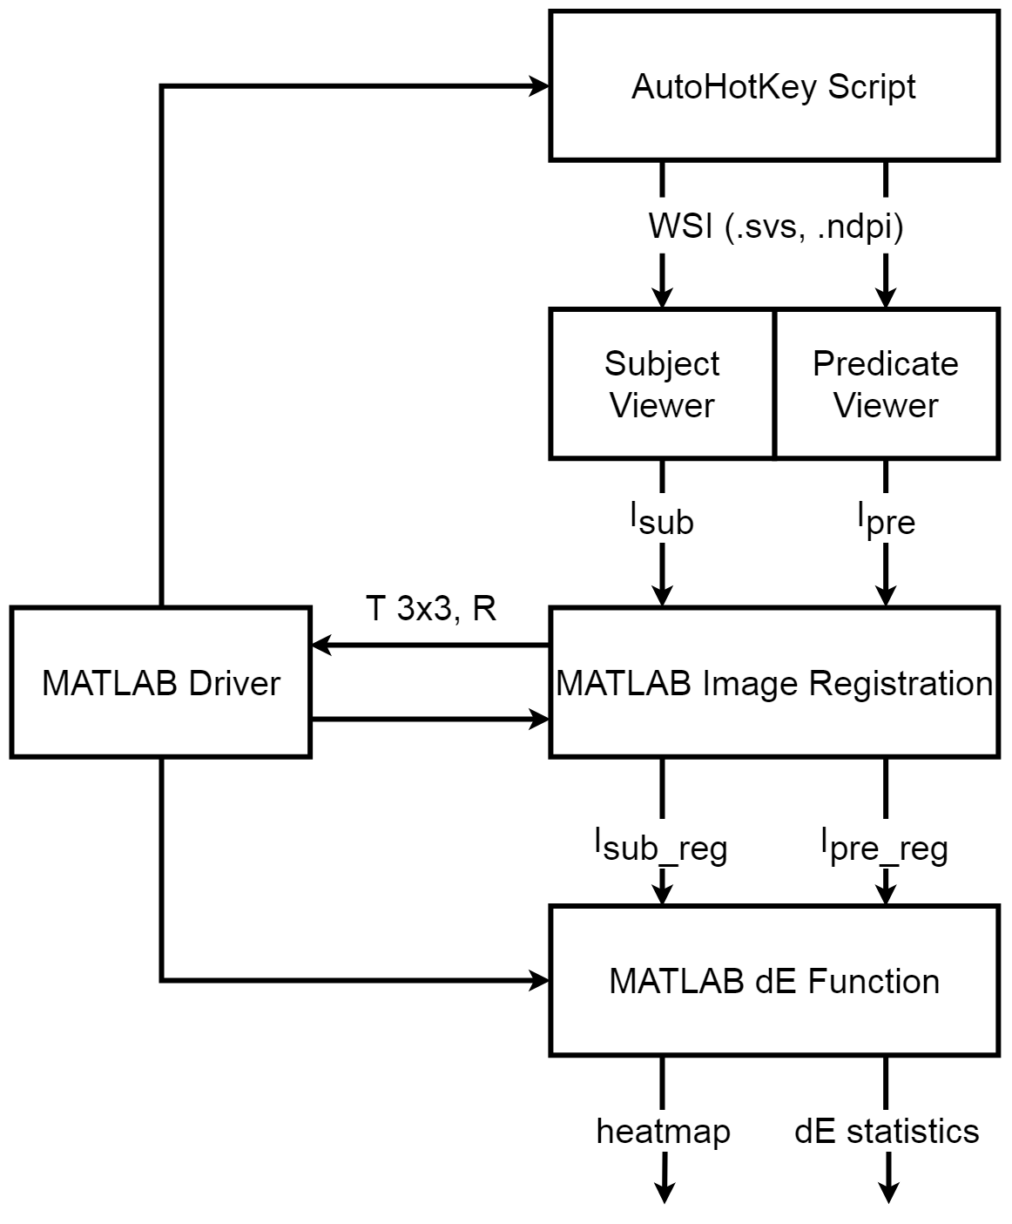
Third-party whole-slide image viewers do not produce the same image
Samuel Lam¹, Qi Gong², Wei-Chung Cheng³
¹Rising junior at University of Maryland, College Park; ²CDRH/OSEL/DIDSR, ³CDRH/OSEL/DIDSR
REGULATORY RELEVANCE
TEST SUBJECTS
∆E Between Pairs of Pixels In Registered Screenshots
Experiments showing that testing data are required to demonstrate image integrity for 3rd-party WSI viewer software.
NDP.view2
Sedeen
QuPath
ASAP
ABSTRACT
Three freely available 3rd-party image viewers were compared with the factory viewer. A software tool was developed to compare them on the pixel level. The results show that some of the viewers rendered the whole slide images very differently compared with the factory one.
from Hamamatsu (reference)
from Pathcore
from Queen’s University Belfast
from Radboud University
BACKGROUND
RESULTS
A WSI system used in digital pathology consists of the scanner, image viewer, and display components. Recently, some independent image viewers were submitted by third-party companies to replace the viewer component used in the predicate device. To demonstrate substantial equivalence between the former and the latter, sponsors were expected to provide bench testing data for review. However, the sponsors frequently did not test their image viewers adequately for image quality.
∆E Between Pairs of Pixels In Registered Screenshots
RESEARCH QUESTION
Do different WSI viewers generate identical images for the same WSI file?
METHODOLOGY
FINDINGS
AutoHotKey Script:
Opens the same WSI file (input) in different viewers
Interacts with the viewers to adjust and match the frame of view
Captures the screenshot in Windows (this captures color information in the digital domain and does not involve the display) [1]
MATLAB:
Registers screenshots and checks their accuracy
Calculates color difference (∆E) for each pixel
Reports statistics (mean, standard deviation)
Generates graphs for display
NDP.view2 and Sedeen generated similar but not identical images (mean ∆E = 1.30)
ASAP and QuPath generated similar images
Large color differences between the two groups
Use of color profile is questionable
JPEG compression artifacts are prominent when comparing certain pairs of viewers.
Blank/void areas remain very similar between viewers.
REFERENCES
Sun, C., Cheng, W-C., How Much Can Bad Display Cost? FDA Summer Student Poster Day 2018.
ACKNOWLEDGEMENTS
This study was supported by ORISE. The mention of commercial products herein is not to be construed as either an actual or implied endorsement of such products by the Department of Health and Human Services. We are grateful to Jonathan Boswell for helping in setting up this study.

